Slide 1
Agile Combat Power Projection
OPR: MSgt Will Brigham
27 SOW
Cannon AFB, NM
CAO:4 April 2025

Slide 2
ACCELERATE
Problem Statement
AFSOC aims to rapidly become more cunning with A2E in response to emerging threats in the near peer arena – and we are not moving fast enough. We need accelerated innovation.
verb (used without object),ac·cel·er·at·ed, ac·cel·er·at·ing.to move or go faster; increase in speed.
to progress or develop faster.

Slide 3
Solution
Modernization, integration and standardization of ALL RPA and conventional aircraft operations. Regular off-station and cross-country training immediately demonstrates agile combat power projection. Self-sustained power generation with smaller and agile logistic footprint allows the Air Force and DoD to open doors to new capabilities and tactics, with AFSOC leading the way.
Move at the speed of War, not the speed of Staff.

Slide 4
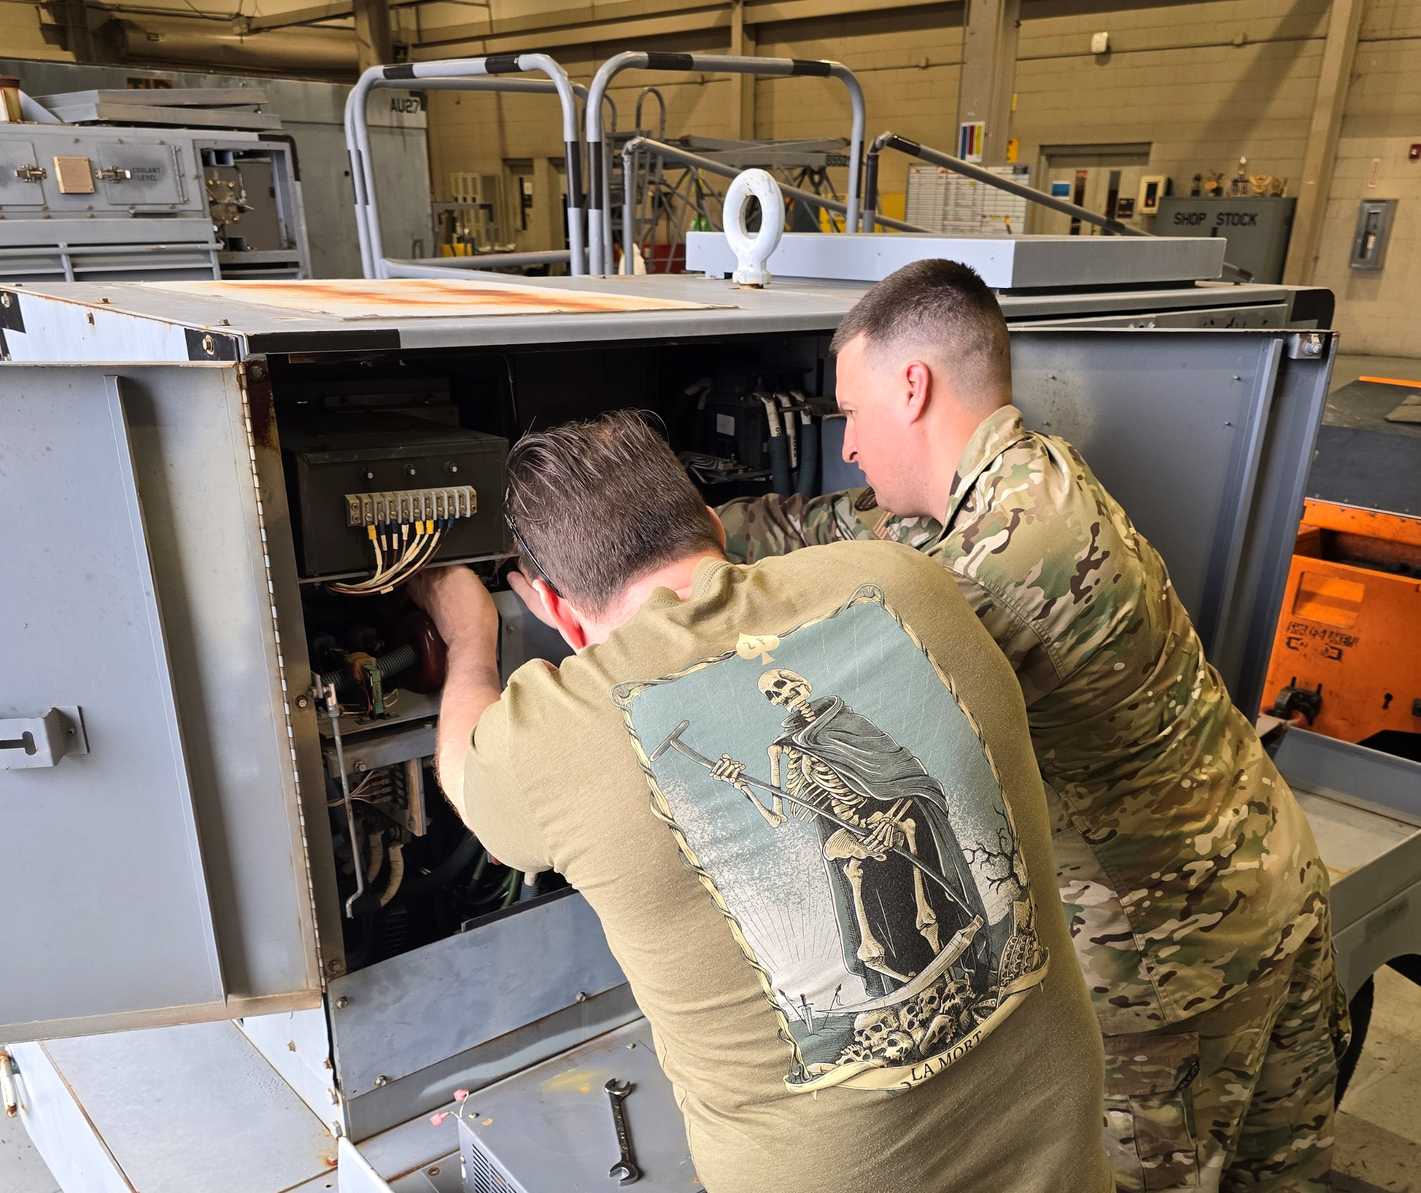
Innovation Meets Progression
RAT's, ADG's and Li-ion Battery Systems
Legacy Operations vs True Air Power Projection
Island Hopping Ops Across Indo-PACOM

Slide 5
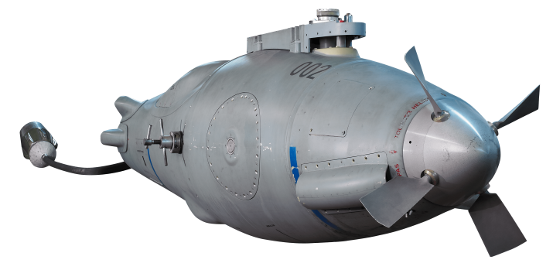
Haste Operations Power Restore (HOPR)

Slide 6
Flow
STAGE 1
Experimentation
Travel Pod Self Start Pod​
- A/A42r as test template - Battery regen kit ​
- Baseline Dash 21 / Flyaway kit - RAT for battery sustainment
STAGE 2
Certification / Validation
ERO / HOT PIT / RELOAD
FARP TESTING
Definitions
Dash 21/Fly Away Kit - chocks, pins, plugs, power cable, ect..
ERO - Engine Running Off-load
FARP - Forward Air Refueling Point

Slide 7
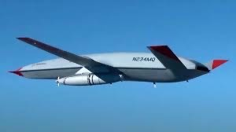
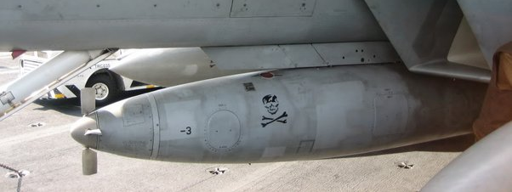
Stages Explained
Stage 1
Ground experimentation phase
This takes 3 weeks or less for each test and can easily be incorporated into A2E demos
Stage 2
Air testing phase
Approximate 3-month duration or less; all systems being considered have already passed some sort of airworthiness testing.
Emerald Warrior 2025
A/A42R-1

Slide 8
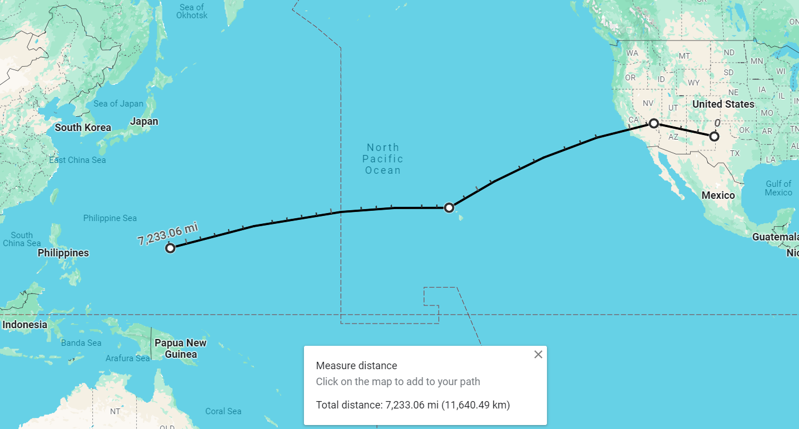
Legacy RPA Operations
- 7233 miles
- 120 knots
Flight time:
2 days, 4.4 hrs
Assumes GSE at each stop with at least 4 hour turn time
Total time:
2 days 20.4 hrs
No divert options

Slide 9
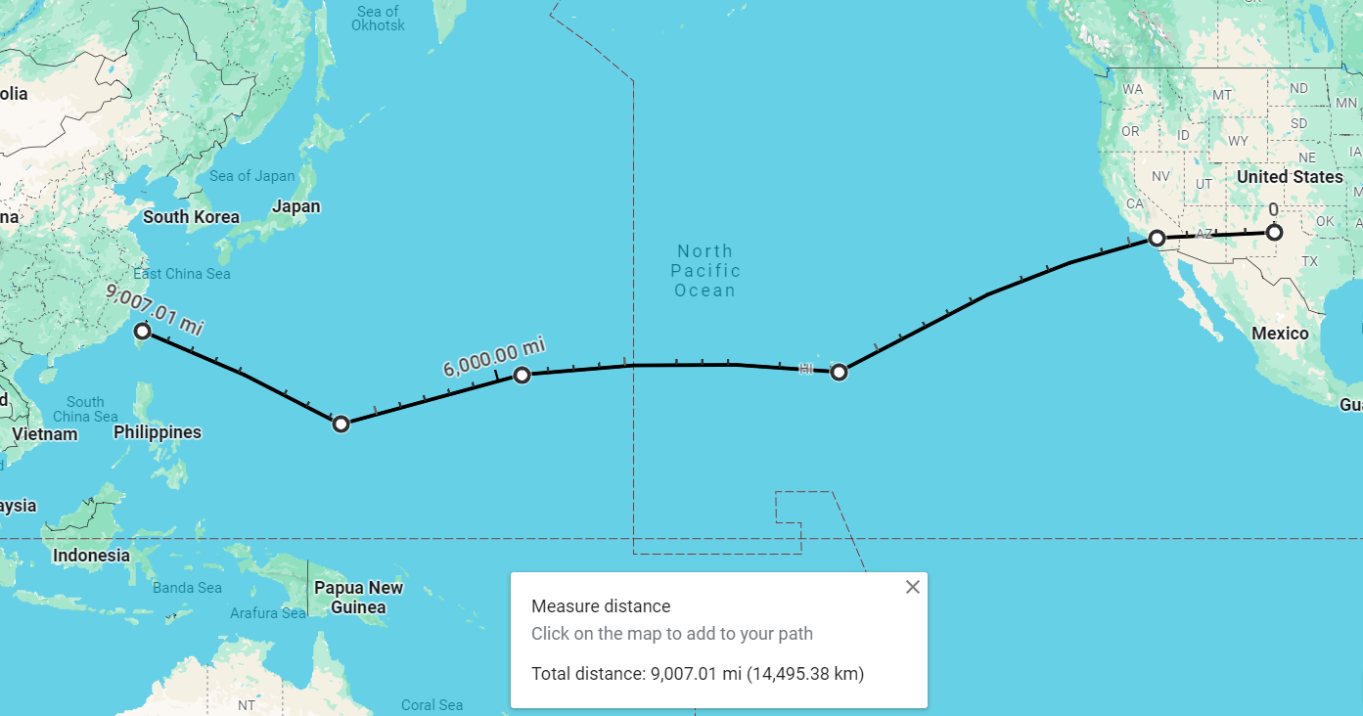
Agile Combat Power Projection
- 9007 miles
- 120 knots
Flight time:
2 days 17.2 hrs
Assumes 45 min turn time with min MX
Total time
2 days 20.9 hrs
Multiple FOLs

Slide 10
What’s Next?
Current Inventory
Funding
Prototypes
Champions

Slide 11
Questions?

